Slide 1
ROAD READY - CAR RENTAL SYSTEM
- MITHRA MUGUNDAN
TRAINER : JAVEED SIR

Slide 2
PROJECT OVERVIEW
PROJECT DESCRIPTION :
RoadReady is a user-friendly, web-based car rental platform enabling customers to search, book, and manage car rentals online.
OBJECTIVE :
To streamline car rentals and reservation management through an intuitive and secure web application.

Slide 3
TECHNOLOGIES USED
Backend:
Spring Boot & Java – REST API development
Spring Security – Authentication & Authorization
JWT – Token-based secure sessions
Database:
MySQL – Structured data storage & relationships
Frontend:
Angular – Component-based UI development
HTML/CSS – Layout and styling

Slide 4
MAIN FEATURES
User Authentication & Authorization
Car Search & Details
Booking System
Secure Payments
Admin Dashboard
User Dashboard

Slide 5
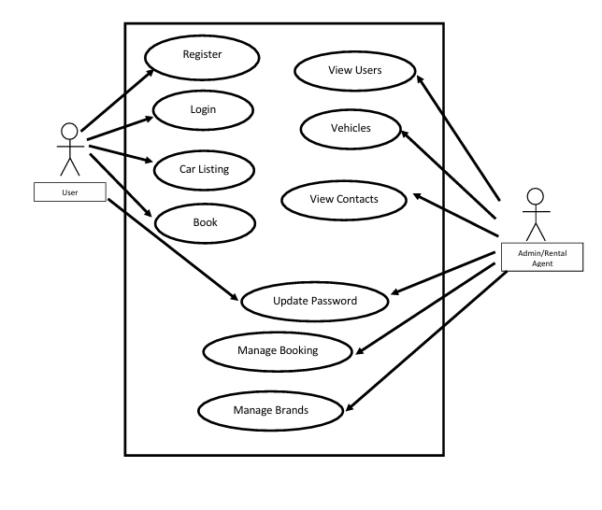
USE CASE DIAGRAM

Slide 6
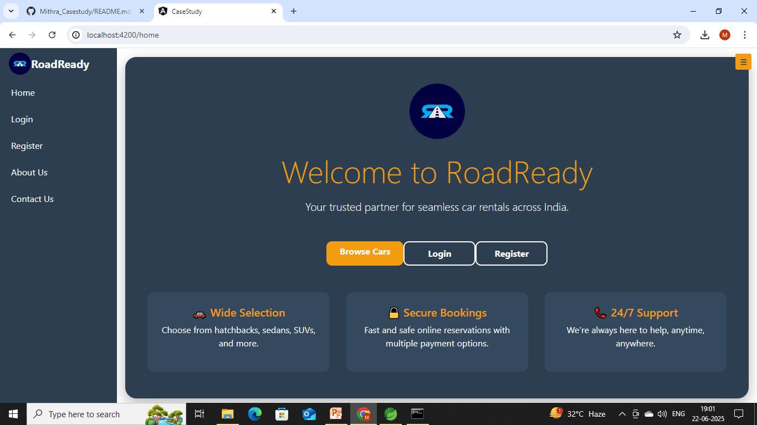
OUTPUT

Slide 7
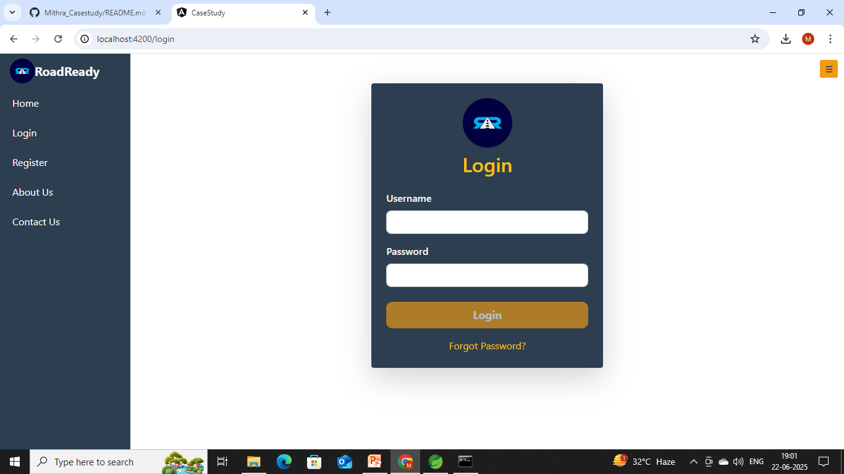
LOGIN PAGE

Slide 8
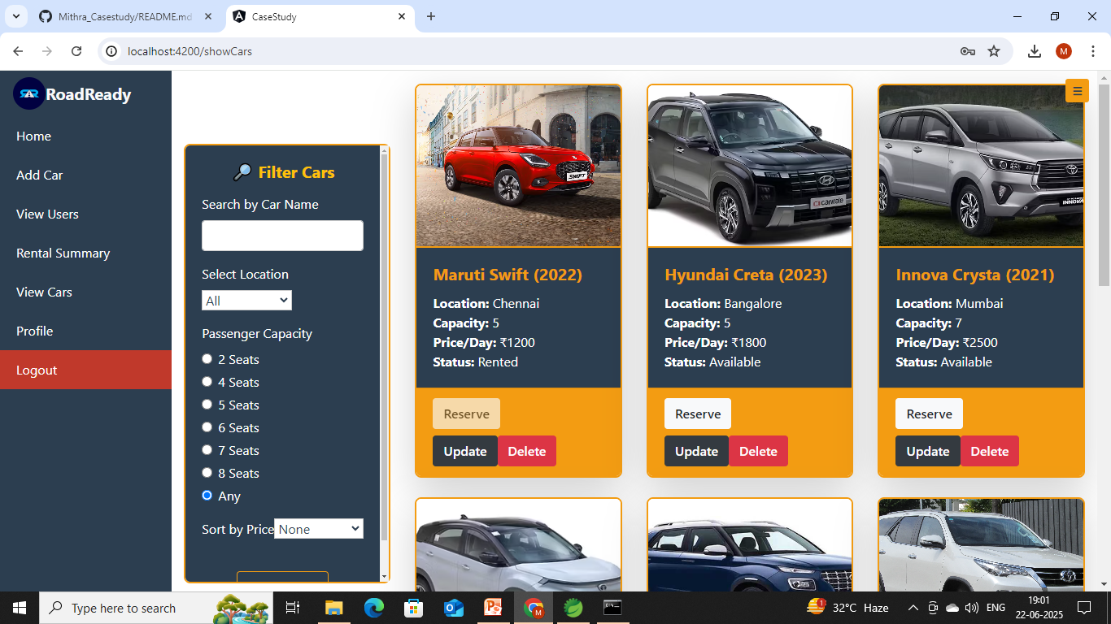
BROWSE CARS

Slide 9
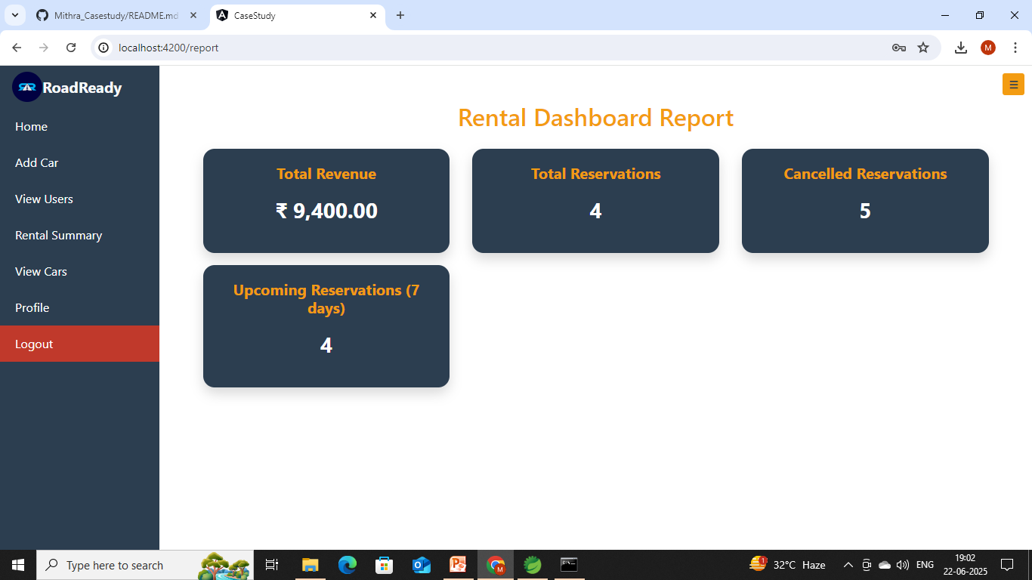
RENTAL SUMMARY

Slide 10
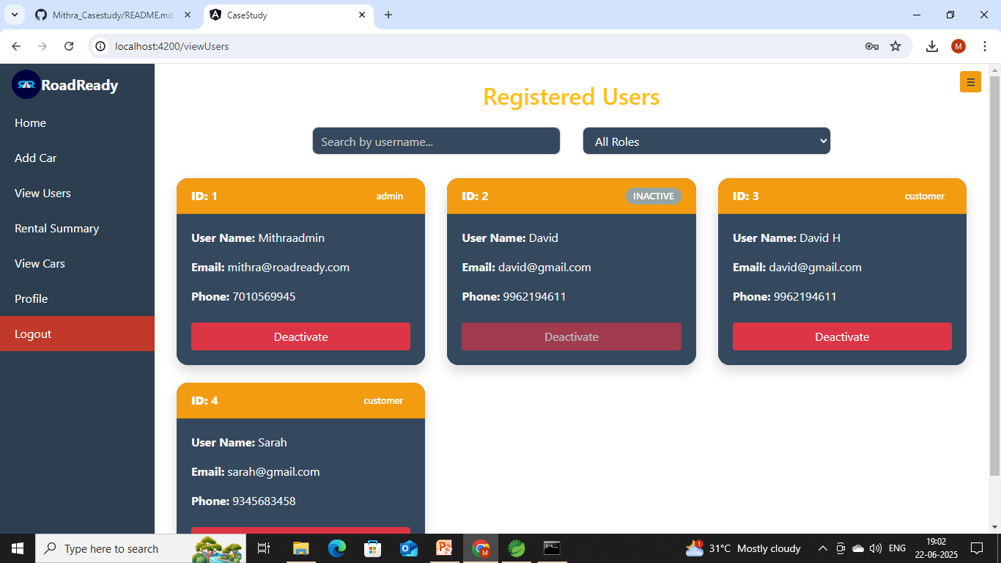
VIEW USER AND ADMIN PAGE

Slide 11
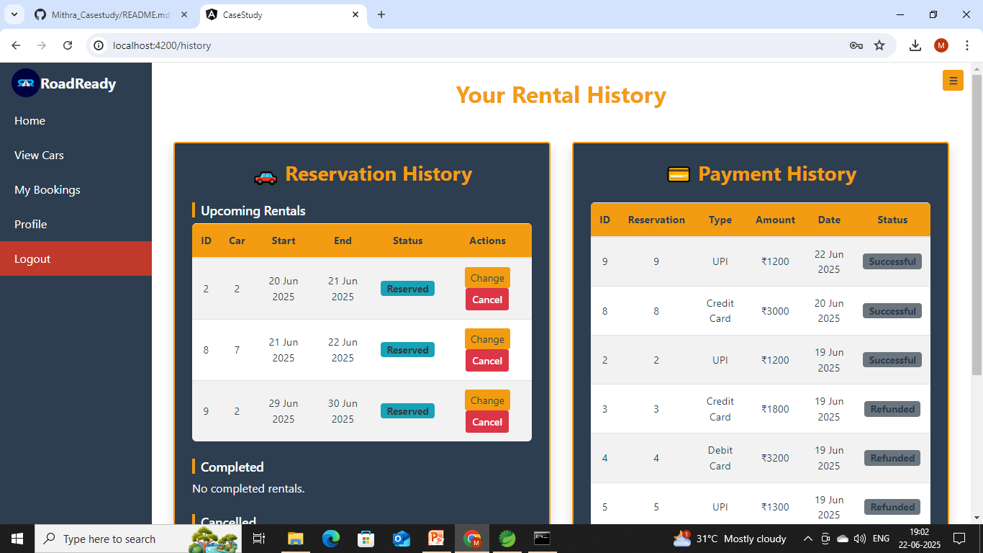
USER RENTAL HISTORY

Slide 12
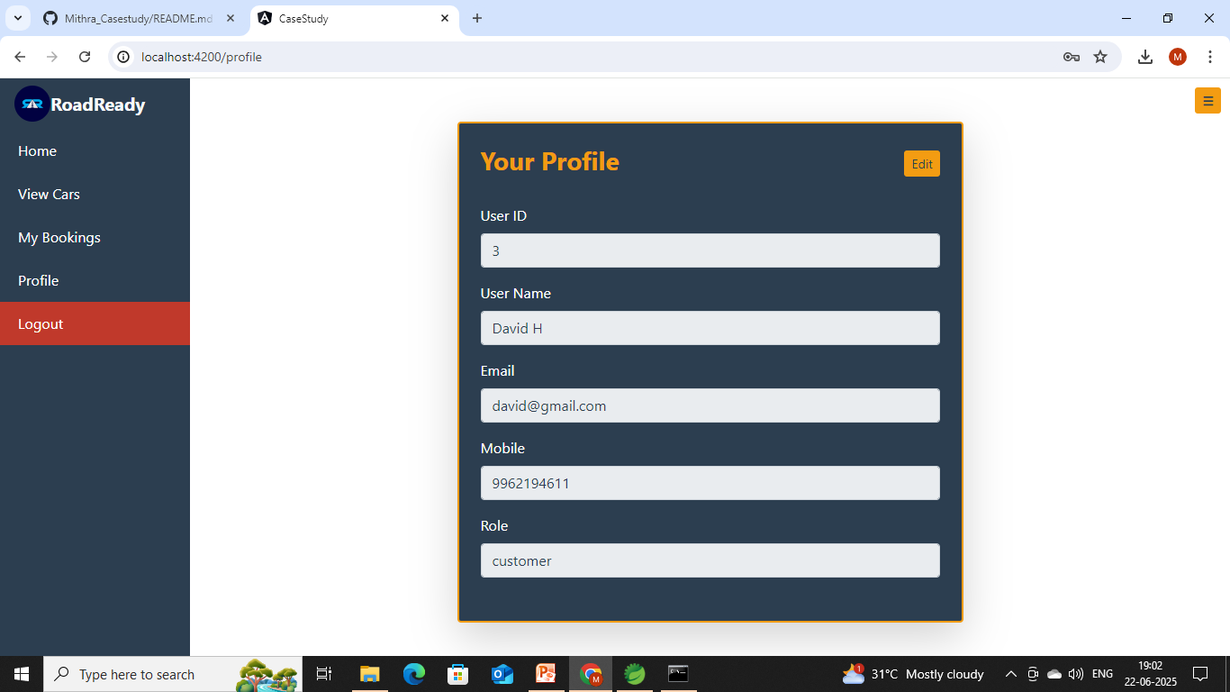
USER PROFILE UPDATE PAGE

Slide 13
THANK YOU

